Slide 1
CS2310 Computer Programming
LT2: Basic Syntax – Variables and Constants
Computer Science, City University of Hong Kong
Semester B 2021-22

Slide 2
Outline
C++ syntax
Variable type, scope, and declaration
Constants

Slide 3
A general C++ program
#include <iostream>
using namespace std;
void main()
{
}
/* Place your code here! */

Slide 4
Syntax
Like any language, C++ has an alphabet and rules for putting together words and punctuations to make a legal program. This is called syntax of the language
C++ compilers detect any violation of the syntax rules in a program
C++ compiler collects the characters of the program into tokens, which form the basic vocabulary of the language
Tokens are separated by space

Slide 5
Syntax – A Simple Program
#include <iostream>
using namespace std;
void main()
{
cout << "Hello, world!\n";
}
#include <iostream>
using namespace std;
void main()
{
cout << "Hello, world!\n";
}

Slide 6
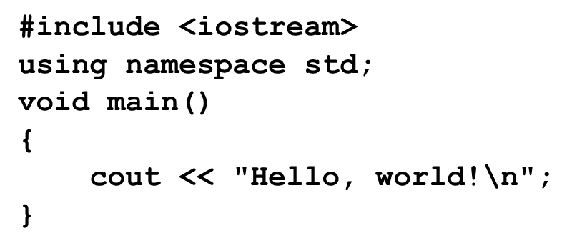
Syntax - Tokens
Tokens can be categorized into:
keywords, e.g., return, namespace, int
identifiers, e.g., user-defined variables, objects, functions, etc.
string constants, e.g., “Hello”
numeric constants, e.g., 7, 11, 3.14
operators, e.g., +
punctuators, e.g., ; and ,

Slide 7
Syntax – A Simple Program
#include <iostream>
using namespace std;
void main()
{
cout << "Hello, world!\n";
}
#include <iostream>
using namespace
std
;
keywords
void
main
(
)
{
punctuators
cout
<<
“Hello, world\n”
;
identifiers
}
String Constants

Slide 8
Keywords (reserved words)
Data type | char | double | float | int | bool
 | long | short | signed | unsigned | void
Flow control | if | else | switch | case
 | break | default | for | do
 | while | continue
Others | using | namespace | true | false | sizeof
 | return | const | class | new | delete
 | operator | public | protected | private | friend
 | this | try | catch | throw | struct
 | typedef | enum | union

Slide 9
Keywords (cont’d)
Each keyword has a reserved meaning and cannot be used as identifiers
Can we have a variable called “main”?

Slide 10
Identifiers
Identifiers give unique names to objects, variables, functions, etc.
Keywords cannot be used as identifiers
An identifier is composed of a sequence of letters, digits and underscores
No hyphen (-)
An identifier must begin with either an underscore (not recommended) or a letter
valid identifier: _income, record1, my_income , My_income
Invalid identifier: 3D_Point, my-income
Always use meaningful names for identifiers
Bad examples: x, xx, xxx, xxxx …

Slide 11
Variables and Constants

Slide 12
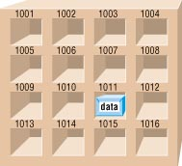
Variables and Constants
Data stored in memory, in binary format.
They do not exist after the program execution.
A variable: its value may be changed during program execution.
A constant: its value will NOT be changed during program execution.

Slide 13
Variables and Constants
Every variable/constant have 3 attributes: type, name and scope
Type: variables/constants must belong to a data type, either predefined or user-defined
Name: identifier of the variable
Scope: it defines where the variable can be accessed, and also the conflict domain for identifiers

Slide 14
Variable Declaration Format
Format
data_type variable/constant_identifier;
Variables and constants must be declared before use
int age;
Variable names
Variable names are composed of the characters:
a,b,c,..,z,A,B,C,…,Z,0,1,2,…,9 and _
Variables names must begin with:
a,b,c,..,z,A,B,C,…,Z or _

Slide 15
Variable Names
Capitalized and lower case letters are different
Examples:
int age;
int age1, age2, Age;
Optionally, the initial value of a variable can be set with declaration.
int age=18;
int age1=18, age2=23;
int age1 = 18,age2 = 23; //Space is okay
Their values are undefined at this point

Slide 16
Variable Names
Which of these are valid variable names?
you
U2
CityU_CS
$Cake
\you
CityU-CS




Slide 17
C++ predefined data types
Numerical
int integer (1, 3, 8 , 3222, 421, 0, -45)
float, double real number (0.25, 6.45, 3.01e-5)
Character
char single character (‘a’, ‘e’, ‘o’, ‘\n’, ‘\\’, ‘\”’)
Logical
bool boolean (true, false)
Other
void empty values

Slide 18
int
Typically, an int variable is stored in four bytes (1 byte = 8 bits).
A 32-bit int can store any integer in the range of -2³¹ and 2³¹ -1, i.e. -2147483648 to 2147483647
When an int is assigned a value greater than its maximum value, overflow occurs; similarly underflow occurs when a value smaller than the minimum value is assigned. However, C++ does not inform you the errors.
Positive (+):
0
1
1
1
+7₁₀
Sign
Negative (-):
1
0
0
1
-(2³¹-1)
11111111 11111111 11111111 11111111 - 01111111 11111111 11111111 11111111
2³¹-1
00000000 00000000 00000000 00000000
0
10000000 00000000 00000000 00000000
-2³¹

Slide 19
short, long and unsigned
short, long and unsigned are special data types for integers.
short x;
long x;
short is used for small integers to conserve space (2 bytes).
long is used for large integers (8 bytes).
unsigned int is of the same size as int (4 bytes) except it assumes the value to be stored is positive or zero. The sign bit can thus be conserved to store a positive integer larger than the maximum value of int (which is 2³¹ -1).
The range of an unsigned int is from 0 to 2³² -1
00000000 00000000 00000000 00000000 - 11111111 11111111 11111111 11111111

Slide 20
Data type char
Used to store a single character, enclosed by the single quotation mark
char c = ‘a’;
char c = ‘\n’;
ASCII codes
A character takes one byte (that is 8 bits, 0 or 1)
‘a’ is stored as the following bit pattern 0 1 1 0 0 0 0 1
It is equivalent to an integer 97 (= 2⁶ + 2⁵ + 2⁰)

Slide 21
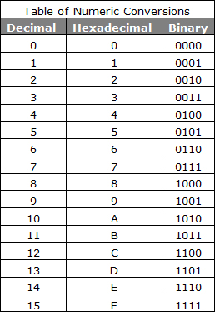
2¹
2³
2⁰
2²
11=1x10⁰+1x10¹
1011
=11
=1x1+1x2+0x4+1x8
Decimal: base is 10!
Binary: base is 2!

Slide 22
Data type char
Used to store a single character, enclosed by the single quotation mark
char c = ‘a’;
char c = ‘\n’;
ASCII codes
A character takes one byte (that is 8 bits, 0 or 1).
‘a’ is stored as the following bit pattern 0 1 1 0 0 0 0 1
It is equivalent to an integer 97 (= 2⁶ + 2⁵ + 2⁰)
Characters are (almost the same as) Integers
Characters are treated as small integers, and conversely, small integers can be treated as characters.
2⁸ = 256, it can represent up to 256 integers

Slide 23
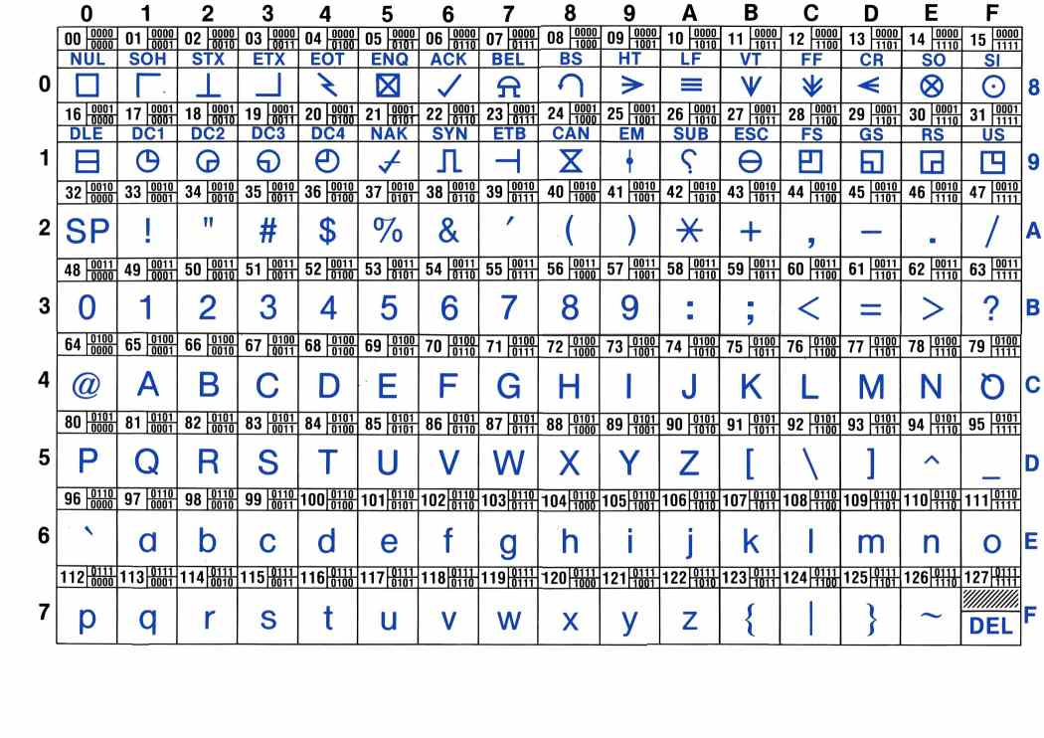
ASCII Code

Slide 24
char as integers
Any integer expression can be applied to char type variables
char c = ‘a’; //c = 97
c = c + 1; // c= 98
cout << “variable c+1 has the character ” << c;
The output will be: “variable c+1 has the character b”

Slide 25
Two’s complement [Optional]
The way that computers represent integers
For a positive integer, two’s complement is the same as the integer
Decimal number 11 in memory
For a negative integer, e.g. -11
Reserve the sign: 11
Invert the bits (0 goes to 1, and 1 to 0)
Add 1 to the resulting number
0 | 0 | 0 | 0 | 0 | 0 | 0 | 0 | 0 | 0 | 0 | 0 | 1 | 0 | 1 | 1
0 | 0 | 0 | 0 | 0 | 0 | 0 | 0 | 0 | 0 | 0 | 0 | 1 | 0 | 1 | 1
1 | 1 | 1 | 1 | 1 | 1 | 1 | 1 | 1 | 1 | 1 | 1 | 0 | 1 | 0 | 0
1 | 1 | 1 | 1 | 1 | 1 | 1 | 1 | 1 | 1 | 1 | 1 | 0 | 1 | 0 | 1

Slide 26
String
A string is a sequence of characters.
A string is treated as an array of characters. We call it cstring.
Strings are delimited by double quotation marks “”, and the identifier must be followed with [] or begin with *
char lecture[] = “CS2310 Lecture02"; or
char * lecture = “CS2310 Lecture02";
char lecture[] = "C"; vs. char lecture = ‘C‘;
How to display: “hello”
Remember escape sequences?
char name[] = "\"hello\"";

Slide 27
Floating types
Represent real numbers using the floating point representation.
float height;
double weight = 120.82;
long double number;
float uses less memory (4 bytes), but is less accurate (7 digits after decimal point); double uses more memory (8 bytes) but more accurate (15 digits after decimal point)
We use double most of the time. It’s also the default type for floating numbers in C++.
Exponent representation is also acceptable, e.g., 1.23e2 (which is 1.23 x 10²) and 3.367e-4 (which is 3.367 x 10⁻⁴)
double weight = 1.23e2;//double weight = 123.0

Slide 28
The sizeof operator
sizeof can be used to find the number of bytes needed to store an object (which can be a variable or a data type);
Its result is typically returned as an unsigned integer, e.g.,
int length1, length2;
double x;
length1 = sizeof(int);
cout<<length1<<endl;
//same as length1 = sizeof(length1);
//or length1 = sizeof(length2);
length2 = sizeof(x);//same as sizeof(double)
cout<<length2<<endl;

Slide 29
Data type conversion
Arithmetic conversions occur if necessary for the operands of a binary operator
A char can be used in any expression where an int may be used, e.g., ‘a’ + 1 is equal to 97 + 1
promotion
demotion

Slide 30
Data type conversion
Implicit type conversion
Binary expressions (e.g. x + y): lower-ranked operand is promoted to higher-ranked operand. //int x = 1; double y = 2.2;
Assignment (e.g. x = y): right operand is promoted/demoted to match the variable type on the left, e.g., int x=1.8; //x will be integer 1.
Explicit type conversion (type-casting)
Example: int i = 10; double j=(double) i;
Demoted values might change or become invalid
E.g., int b=(int)(2147483647.0*3);//(2³¹ -1)*3
promotion
demotion

Slide 31
Constants
Everything we covered before for variables can be applied to constants
type, name, scope
Declaration format:
data_type variable/constant_identifier = value;
const data_type variable/constant_identifier = value;
Examples:
const float pi = 3.14159;
const int maxValue = 255;
const char initial = ‘D’;
const char student_name[] = ”Andy Lau”;

Slide 32
Scope

Slide 33
Variable Scope – Local vs. Global
Scope of a variable refers to the accessibility/visibility boundary of a variable
We need to be able to “see” a variable in order to access it
Local variables
Declared in a block {} and can be only accessed within the block
Try to access a local variable outside the block will produce unpredictable result

Slide 34
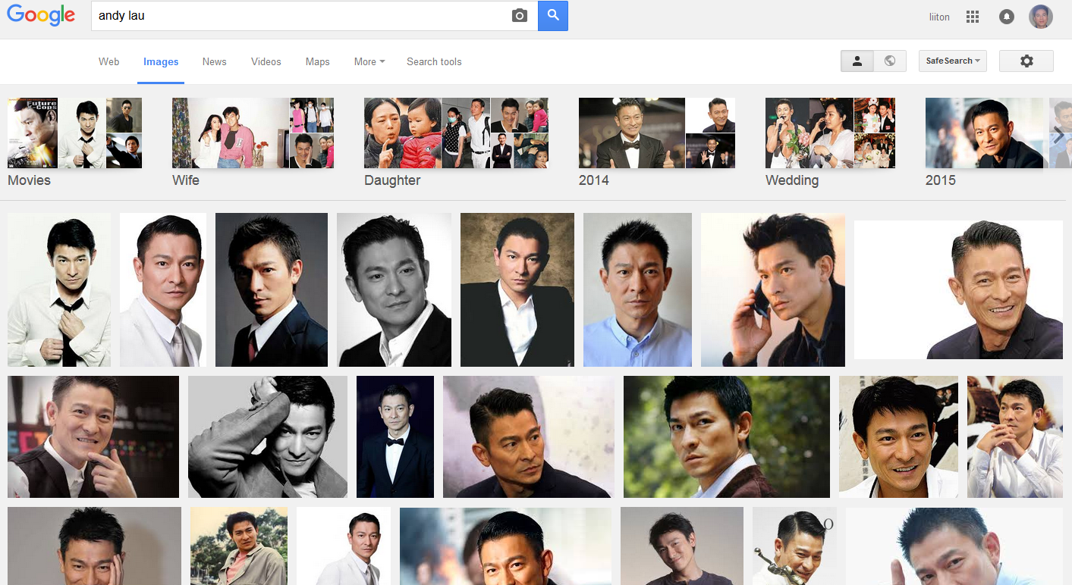
Andy Lau?

Slide 35
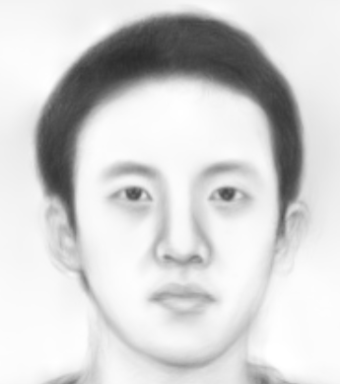
Andy Lau?
CS2310
Two variables/functions/objects may have the same name.
E.g., libraries from two developers.

Slide 36
Global and local variables
The local variable makes the global variable with the same name out-of-scope inside the function – it “hides” the global variable
The same applies to local variables with different scopes
void main(){
int x = 11;
cout << x << ".\n";
{
int x = 10;
cout << x << ".\n";
}
cout << x << ".\n";
}

Slide 37
Scope and namespace
A scope can be defined in many ways: by {}, functions, classes, and namespaces
Namespace is used to explicitly define the scope. A namespace can only be defined in global or namespace scope.
The scope operator :: is used to resolve scope for variables of the same name.

Slide 38
Scope and namespace
int a = 90; // this a is defined in global namespace
namespace level1 {
int a = 0;
namespace level2 {
int a = 1;
}
}
Inside the main function, we can then resolve the variable’s scope
// :: resolves to global namespace
cout << ::a << "\n";
cout << level1::a << "\n";
cout << level1::level2::a << "\n";

Slide 39
Simple Program
#include <iostream>
using namespace std;
void main()
{
cout << "Hello, world!\n”;
}
#include <iostream>
void main()
{
std::cout << "Hello, world!\n”;
// :: resolves to std namespace
}

